Slide 1
Predicting WNBA Success from College Performance
Capstone Progress Update

Slide 2




Agenda
z
Data
Problem
Goal
Model
Next Steps

Slide 3

Data
z
Data Sources:
https://www.sports-reference.com/cbb/
NCAA Women’s College Stats (Back to 2001)
https://www.basketball-reference.com/wnba/players/:
WNBA Stats (All)
https://herhoopstats.com/
Useful for team data

Slide 4
Sample Size & EDA
z
Modeling Dataset:
760 rows
Out of 1028 WNBA players ever
The rest are international players, college data doesn’t go back pre 2001
~20-50 records were improperly scraped and will be added
84 features (initially 60, but continuing to add engineered features)
College Teams
Conferences
Awards
Height

Slide 5
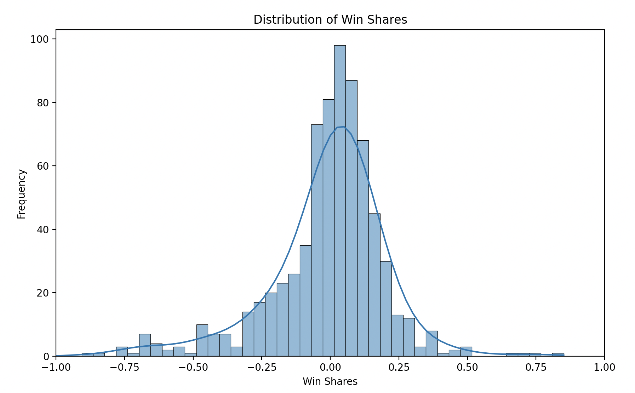
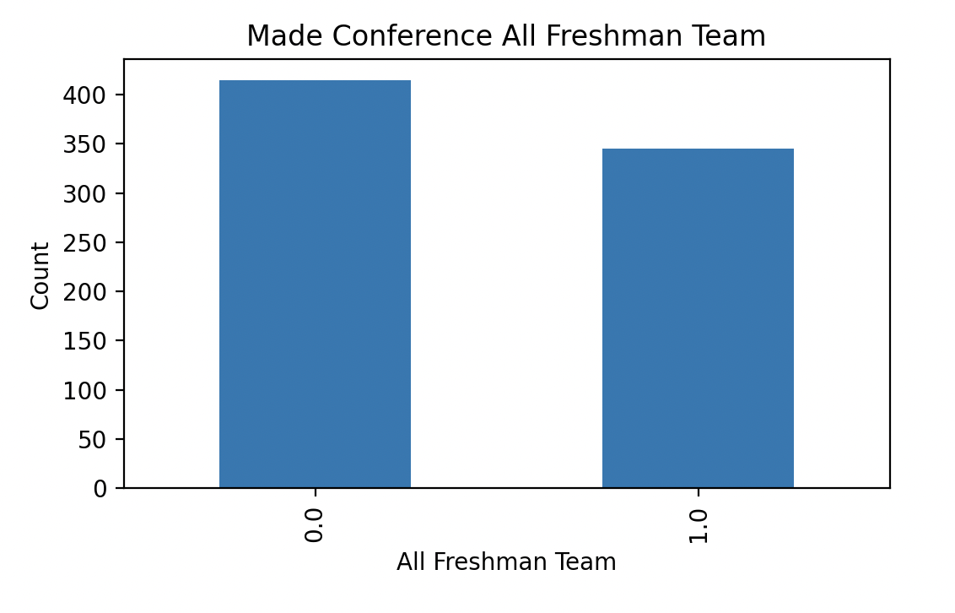
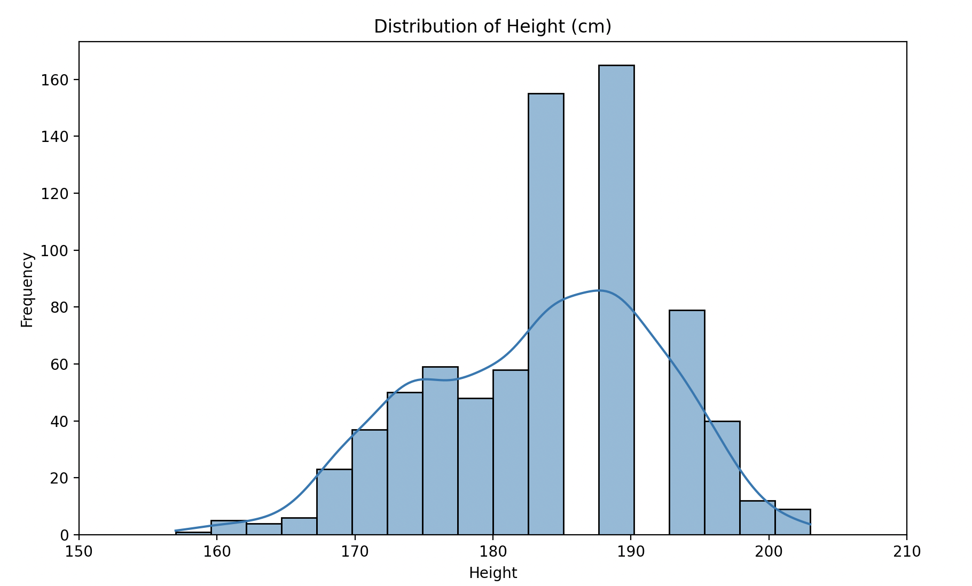
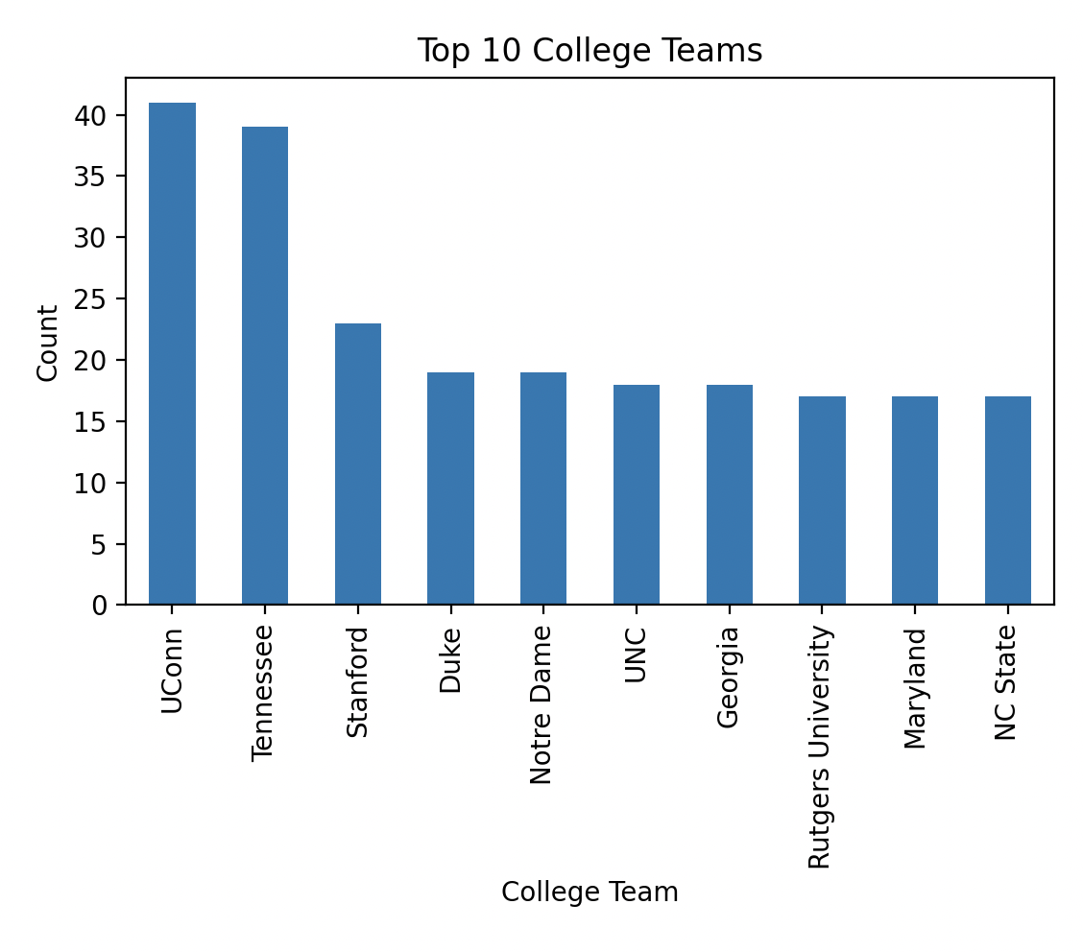
Sample Size & EDA
z

Slide 6

Problem: Predicting College Players WNBA Success
z
Problem Statement:
Determining what college players would have been successful in the WNBA
What defines a successful WNBA player?
What is the best WNBA statistic to determine whether or not a player has had a successful WNBA career. Win Shares appears to be the perfect metric for this.
WNBA Performance Definition:
Win Shares Per 48 Minutes (WS/48): an estimate of the number of wins contributed by a player per 48 minutes
Target Feature:
1: WS/48 >0
0: WS/48 <=0
Explanation
Why:
Incorporates offense and defensive value as well as league
Easily interpretable: Positive means you added wins to the team and negative means you took away wins from your team
Target feature is balanced

Slide 7
Goal: Predictive Classification Model
z
The goal of the research is to predict college players that would have a positive Win Shares value for their career.
Modeling Process
Data scraping
Data cleaning
EDA
Fill Missing Values: imputed median for numerical values
Feature engineering
Feature selection
Finding
Build models with hyperparameter tuning: Random Forest, SVM, XGBoost

Slide 8
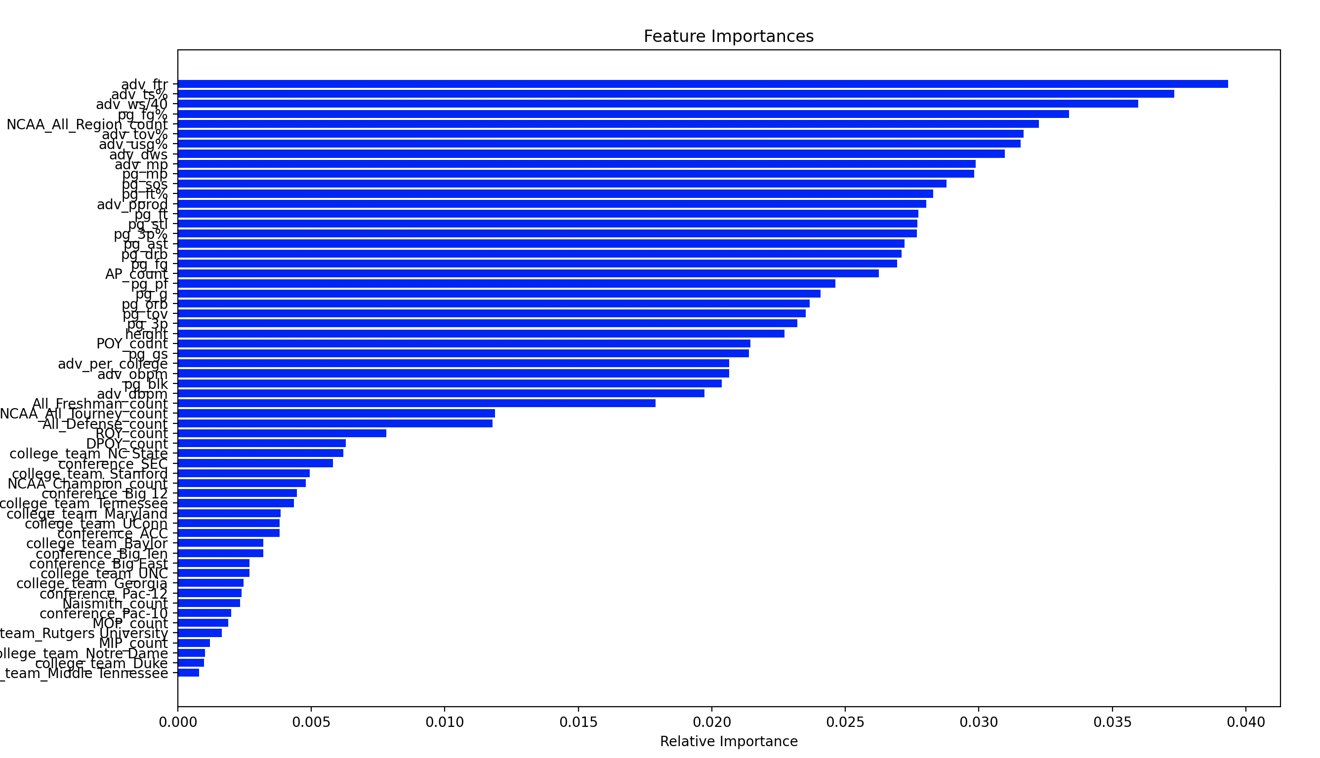
Modeling: Feature Selection
z
Remove highly correlated features (greater than .85)
See most important features with benchmark random forest model
Kept top 20 features

Slide 9
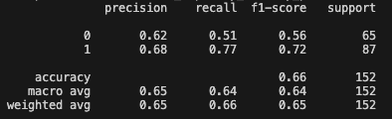
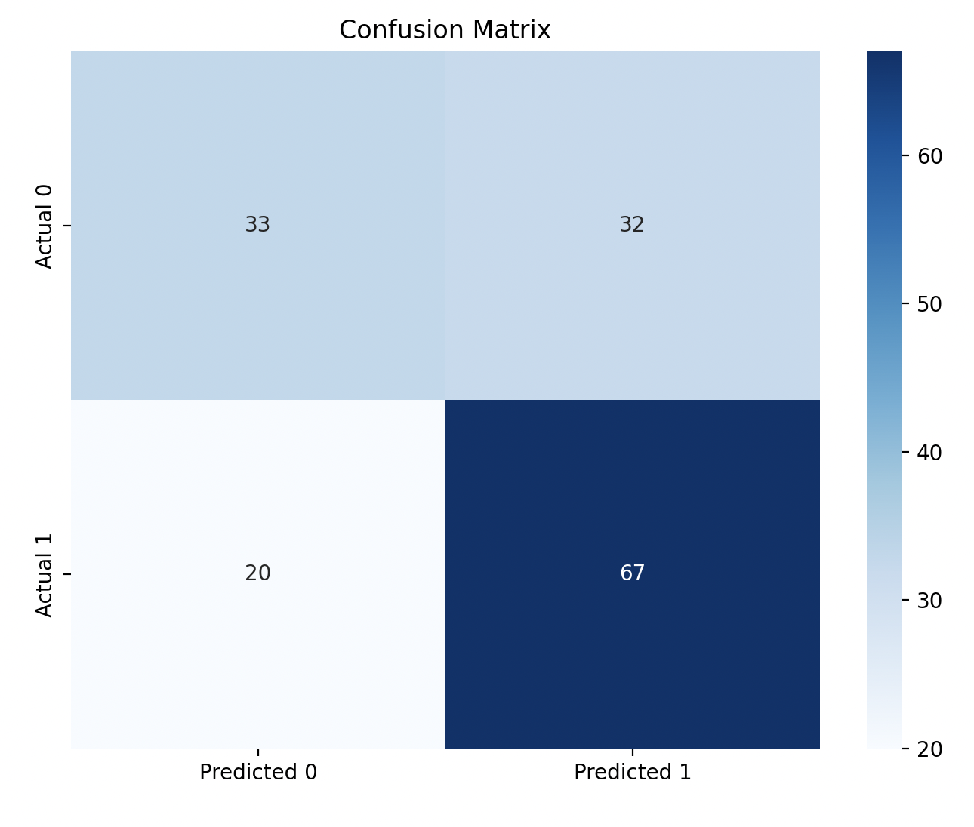
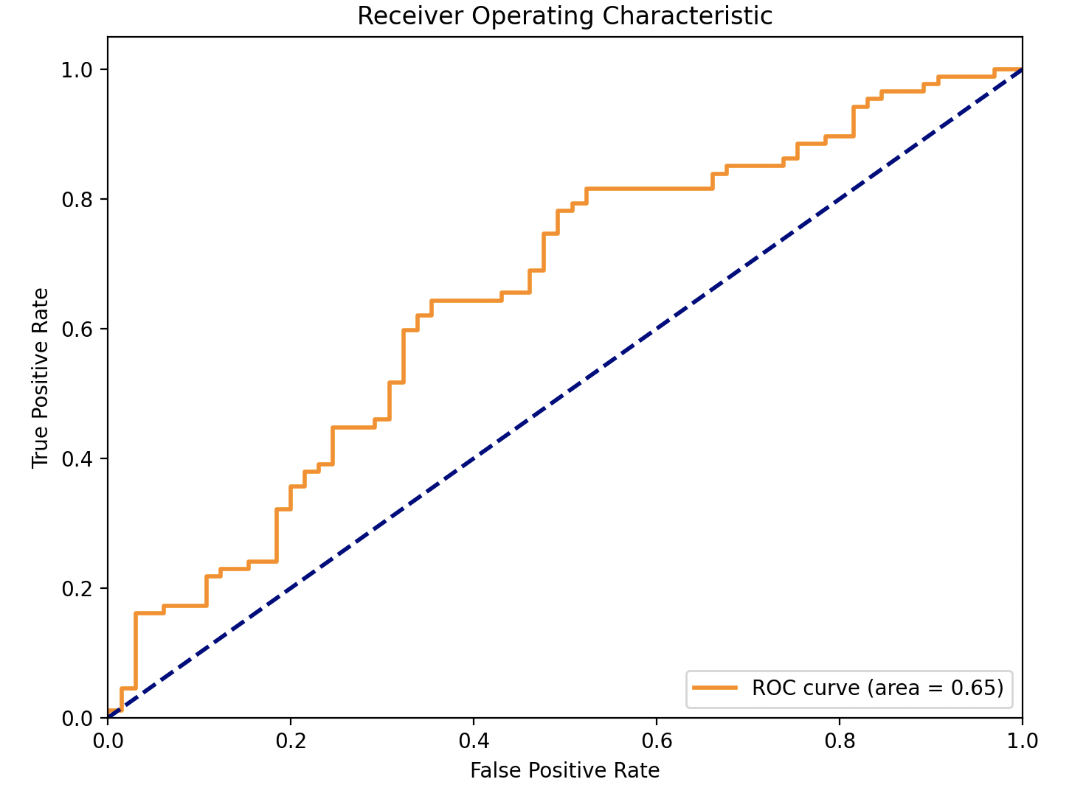
Best Model: XGBoost
z
Parameters: {'learning_rate': 0.01, 'max_depth': 5, 'n_estimators': 150}

Slide 10
Next Steps
z
Scrape ~20-50 records that were missed
More feature engineering
Specifically with awards column (free text field)
Include additional fields
Team performance stats
Additional player totals
Apply model to recent years
2022-23 Season: Show which players will be successful in the WNBA
2021-22 and Prior: Show which players who are not in the WNBA would have been successful
Write Up/Web App to report results

